Slide 1
Loan Defaulter Prediction
Name – Manoj raj s
Upgrad Data science AI/ML – March 2023 Batch

Slide 2
Problem Statement
To classify if the borrower will default the loan or no, using the borrower's finance history.
To come up with the predictor variables which determine the risk of loan approval

Slide 3
Target Variables
The Target Variable for this case study is – Loan_status
Target Component | Description
Fully Paid | The applicant has fully paid the loan (the principal and the interest amount).
Current | The applicant is in the process of paying the instalments, i.e., the tenure of the loan is not yet completed. These candidates are not labelled as ‘defaulted’.
Charged Off | The applicant has not paid the instalments in due time for a long period, i.e., they have defaulted on the loan.

Slide 4
Predictor Variables
Below are some of the predictor variables which decide on the applicant’s loan approval.
Variables | Description
Purpose | A category provided by the borrower for the loan request.
Grade | LC assigned loan grade
Term | The number of payments on the loan.
Verification Status | Indicates if income was verified by LC, not verified, or if the income source was verified
Issue_date | The month & year of loan issued
Loan_status_Num | Boolean component of Target Variable
Emp_length | Employment length in years.
Annual_inc | The self-reported annual income provided by the borrower during registration.
Annua_inc_range | Annual_income ranges b/w Low, Mid, High
Int_rate | Interest Rate of the loan

Slide 5
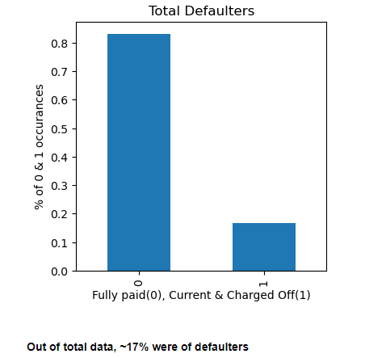
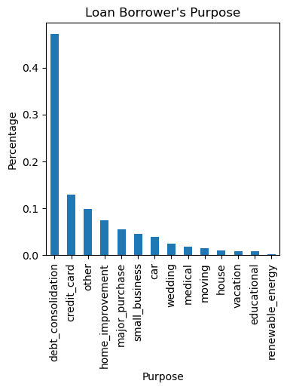
Univariate Analysis

Slide 6
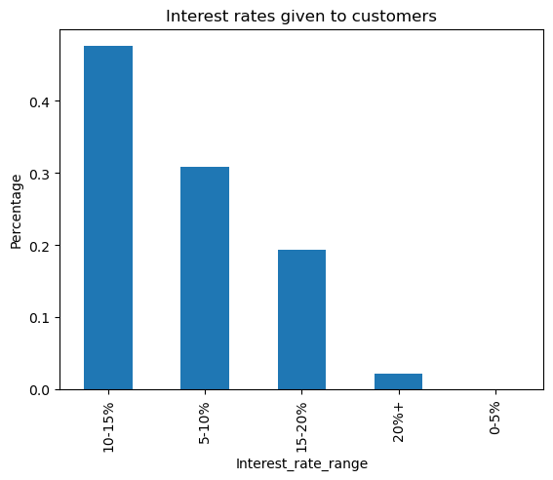
Univariate Analysis

Slide 7
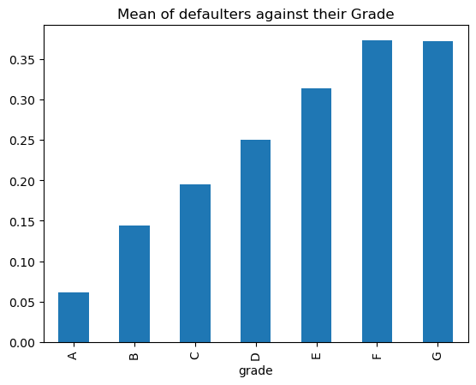
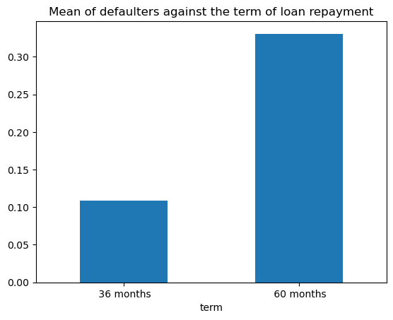
Bivariate Analysis

Slide 8
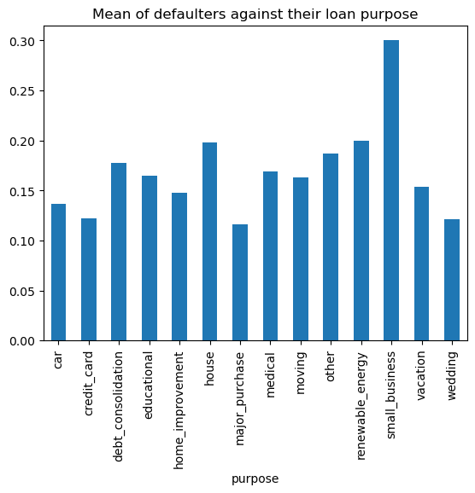
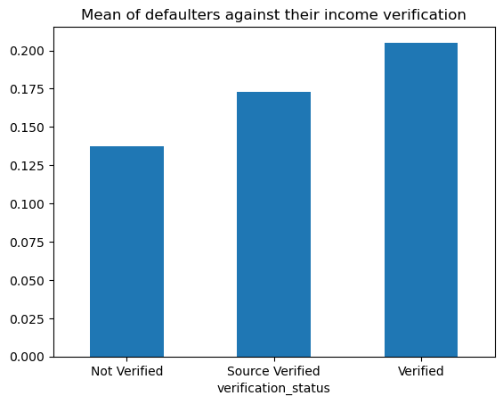
Bivariate Analysis

Slide 9
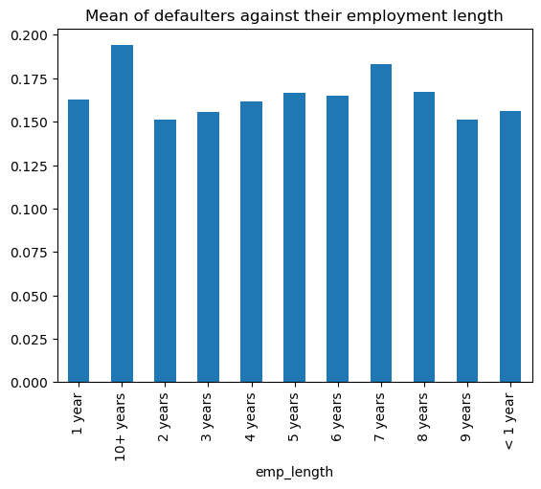
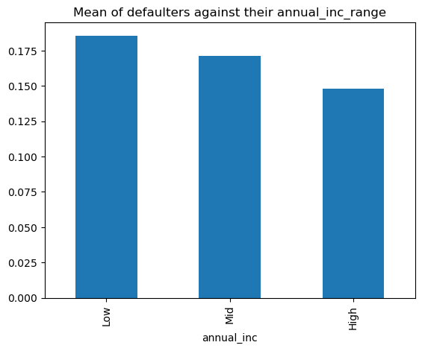
Bivariate Analysis

Slide 10
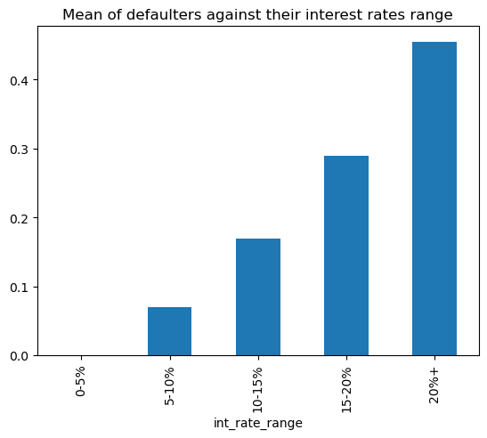
Bivariate Analysis

Slide 11
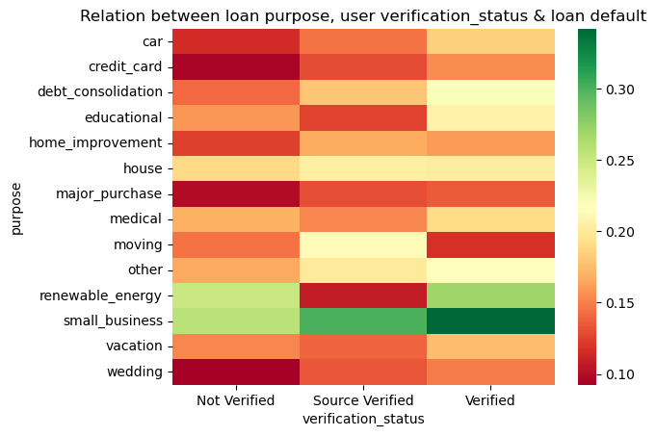
Multivariate Analysis

Slide 12
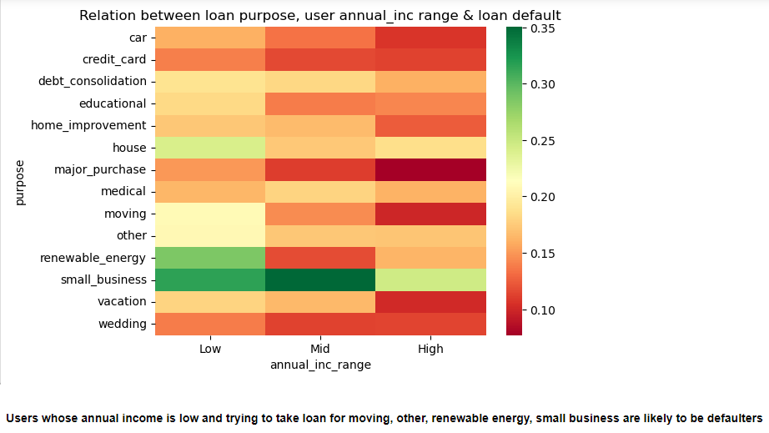
Multivariate Analysis

Slide 13
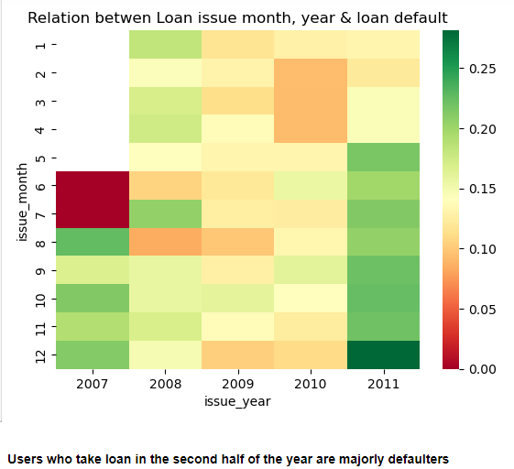
Multivariate Analysis

Slide 14
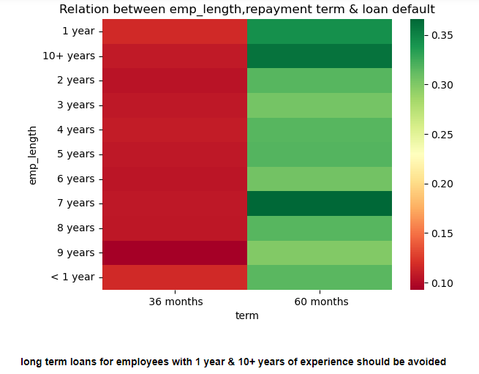
Multivariate Analysis

Slide 15
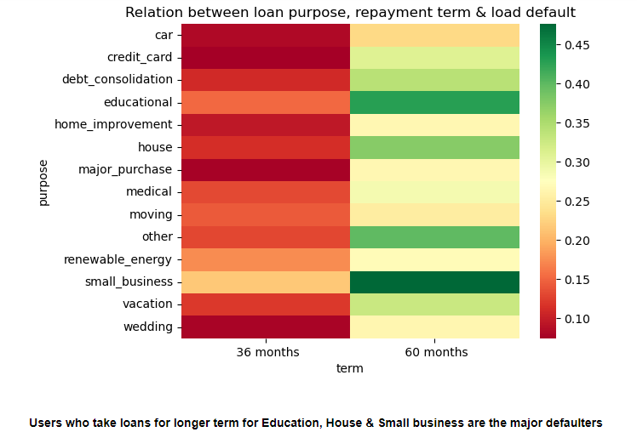
Multivariate Analysis

Slide 16
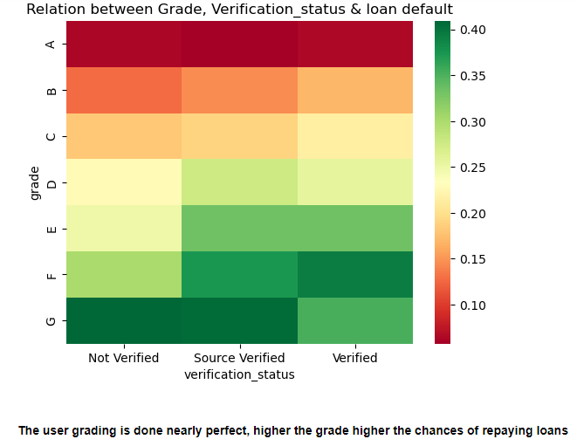
Multivariate Analysis

Slide 17
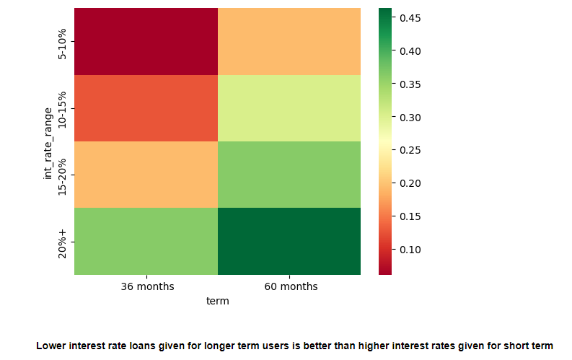
Multivariate Analysis

Slide 18
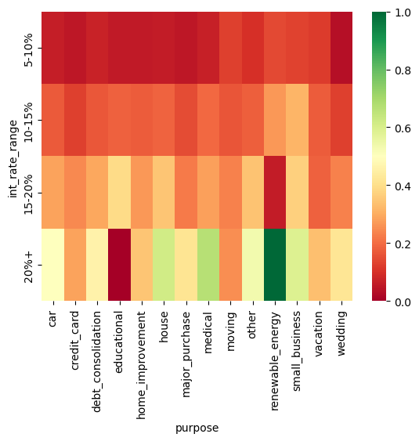
Multivariate Analysis

Slide 19
Conclusion
Prioritize high grade loans
Scrutinize purpose of loan
Offer reduced repayment terms such as 48 months etc.
Ensure verification is complete for all loans disbursed
Engage more with employees with experience over 1 year and lesser than 10 to expand the pool by learning about their needs
For seasonal spending, spend additional time reviewing applications that are likely to default based on further analysis
Evaluate the reason for loan defaults which are disbursed in the second half of the year
Ensure that loans are disbursed only for users with salary greater than 60k
Ensure loans are disbursed under 18% interest rates for avoiding defaulters irrespective of loan term, emp_length, verification status & loan purpose (except educational, credit card, moving purpose)

